Slide 1

Protein-based Water Filter
Notes:
https://www.carolina.com/bacteria/escherichia-coli-living-k-12-strain-nutrient-broth-tube/155068.pr

Slide 2
> 1 Billion People
Lack Access to
Potable Water Today

Slide 3
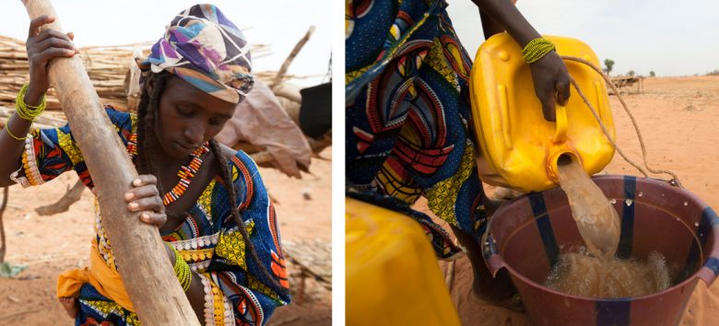
Rhoda’s Story
Notes:
Rhoda, a mother of four children, have to drink unsafe water from shallow wells.
As Rhoda explains: “The water was really bad. Sometimes, you could see the germs with your own eyes. We were supposed to add chemicals to clean it, but we were so poor, we couldn’t afford them. People were getting diarrhea, dysentery, and even cholera.”
After UNICEF dug a much deeper well to reach clean water, Tamadani and his family were able to get 100 liters of safe water daily for bathing, cooking, drinking, and washing clothes and dishes. Now, Rhoda says, “People don’t get sick because of the water [anymore].”

Slide 4
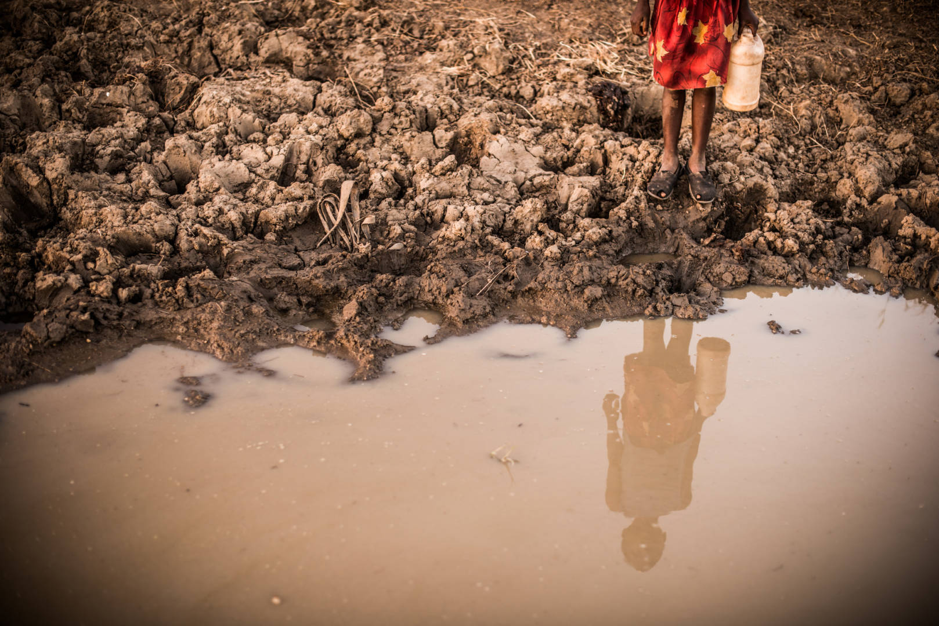
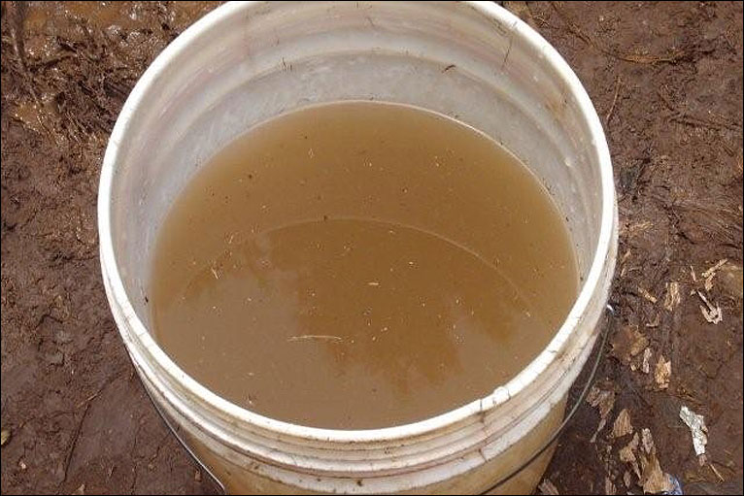
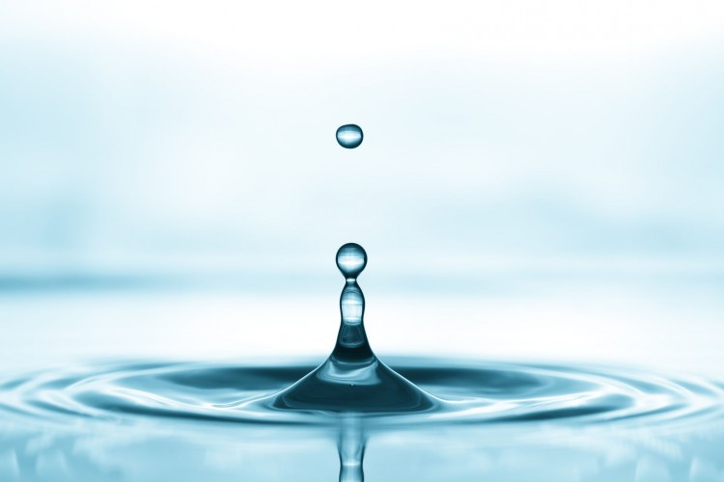
“Sometimes, you could see the germs with your own eyes.
We were supposed to add chemicals to clean it, but we were so poor, we couldn’t afford them.
People were getting diarrhea, dysentery, and even cholera.”
- Rhoda
Notes:
http://news.bbc.co.uk/media/images/46424000/jpg/_46424101_dirty_water766.jpg
https://www.happinessishomemade.net/wp-content/uploads/2015/07/Drink-Water.jpg
https://alivenewspaper.com/wp-content/uploads/2018/04/Cases-of-Unsafe-Drinking-Water-in-the-US-Already-in-2018.jpg

Slide 5
Problems
Typhoid Fever
Trachoma
Schistosomiasis
Malaria
Intestinal worms
HIV/AIDS Infection
Guinea worm disease
Fluorosis
Cholera
Arsenicosis
Diarrhoea
Cryptosporidium
Cyclosporiasis
Dysentery
Gastroenteritis
Giardiasis
Hepatitis E Infection
Salmonellosis
Escherichia coli 0157:H7 (E. coli) Infection
Hepatitis A Infection
Campylobacteriosis
Acanthamoeba keratitis
Amoebiasis
Microsporidiosis
Botulism
Legionellosis
Leptospirosis
Otitis Externa
Vibrio Illness
SARS
Acute gastrointestinal illness
Poliomyelitis
Polyomavirus infection
Desmodesmus infection
M. marinum infection
Naegleriasis
Notes:
Wait for it…. Host of diseases (be impactful!)
How to detect when the protein degenerates
Filter out detergent

Slide 6
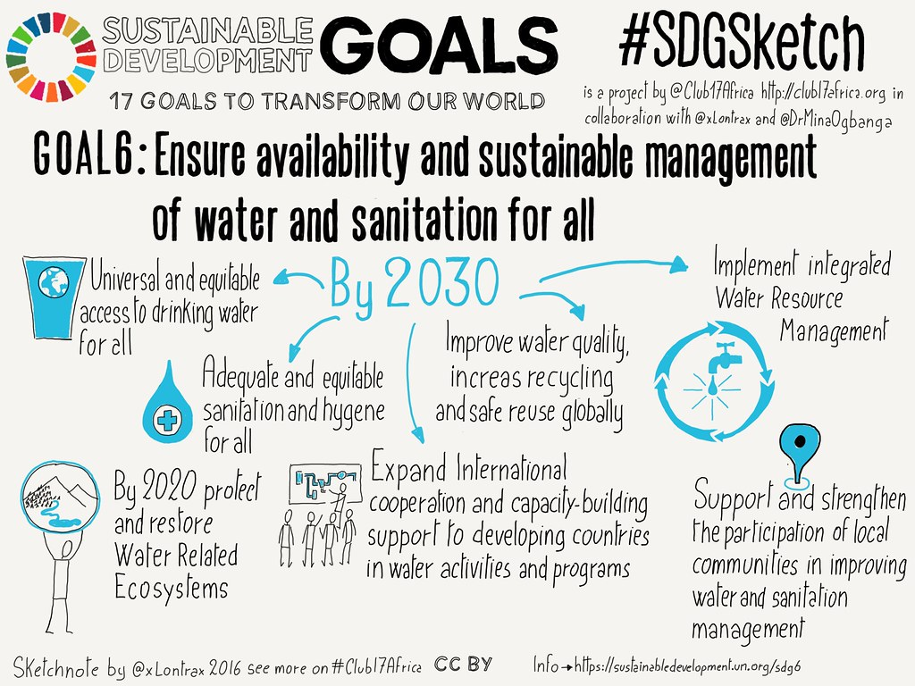
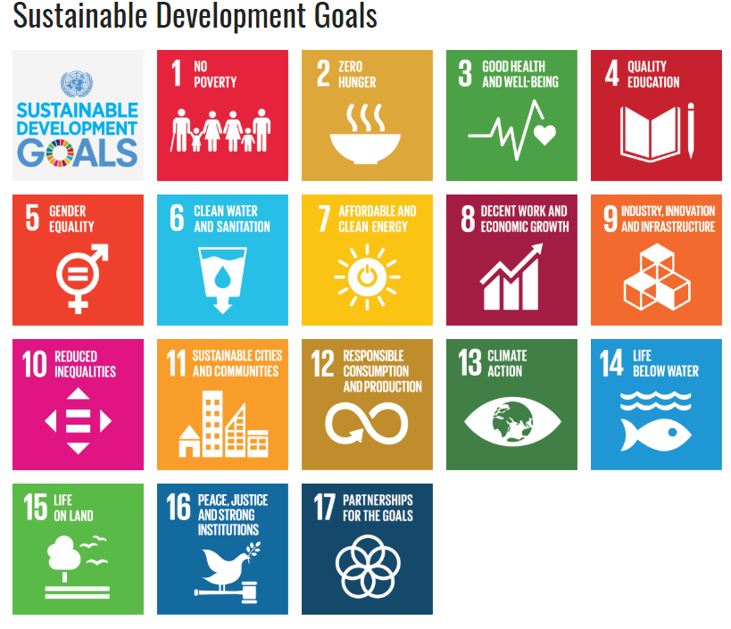
Relevance to Global Health
Target: Achieve universal and equitable access to safe and affordable drinking water for all, by 2030.
Notes:
https://c1.staticflickr.com/9/8541/29283057715_599f0d38bb_b.jpg
https://sustainabledevelopment.un.org/?menu=1300

Slide 7


Slide 8
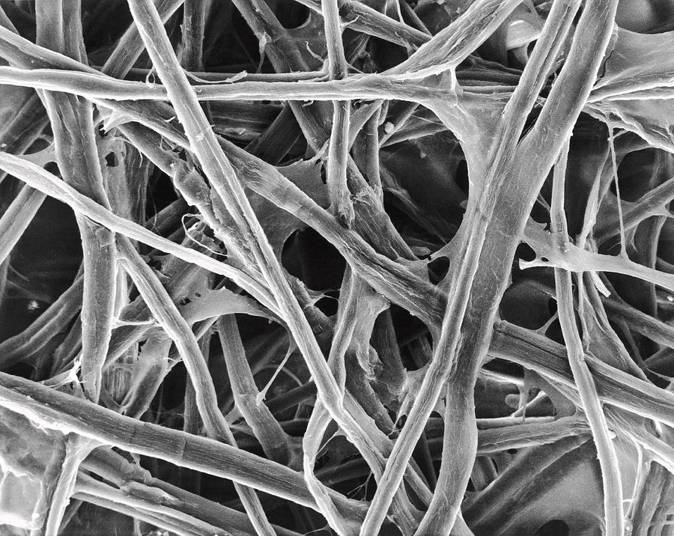
A cellulose encrusted with E. Coli membrane
Drinkable water! Only lets pure water and and electrolytes through.
Filtratration at an Angstrom scale!
Safe, only the membrane of the E. Coli is used
Product is organic and biodegradable
Notes:
-Fragmenting E coli and making a highly saturated solution with the membranes. Filtering the solution through the cellulose sheet. To have a membrane protein filter.

Slide 9
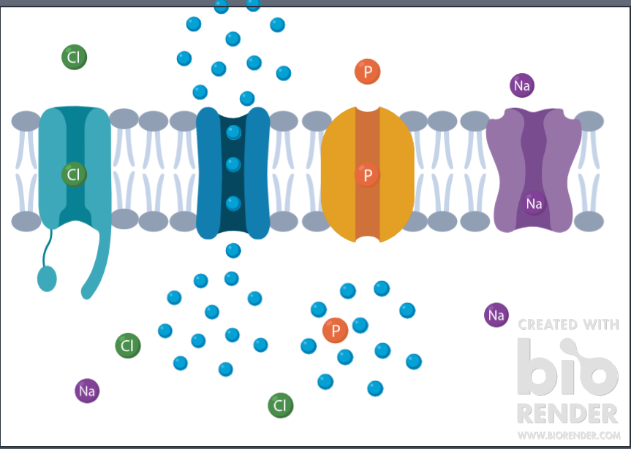
E. Coli Membrane
Outside the Cell
Inside the Cell
Notes:
-Pores for electrolytes
-Aquaporins
-E coli have on of the most efficient aquaporins

Slide 10
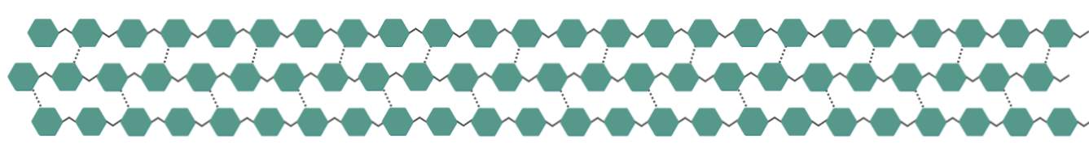
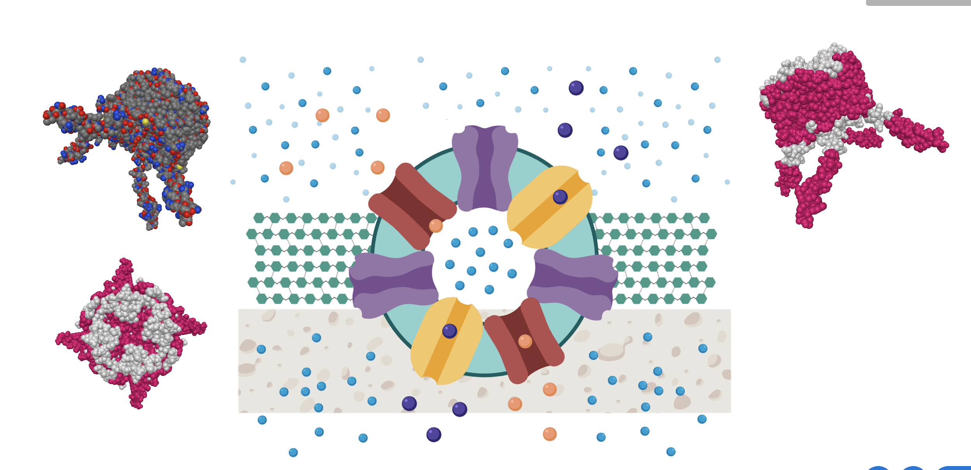
Composition of Filter
Cellulose Layer
H₂O with contaminants
H₂O with desired electrolytes
Models built using BioRender
Notes:
Normal cellulose filtration to remove big dirt
Removing all impurities
Just water and electrolytes

Slide 11

Membrane Protein Filter

Slide 12
Tackling the Issue
Rural Communities
First World Consumers
United Nations
First World Retailers

Slide 13
United Nations Basic Level Contract
United Nations Level 1 and 2 Contract & First World Retailers
Sustainable Way to Empower Rural Communities
Without the Access to
Clean Water
First World Retailers

Slide 14
2.62 GBP
Manufacturing Cost
Per Meter Squared (Filter)

Slide 15
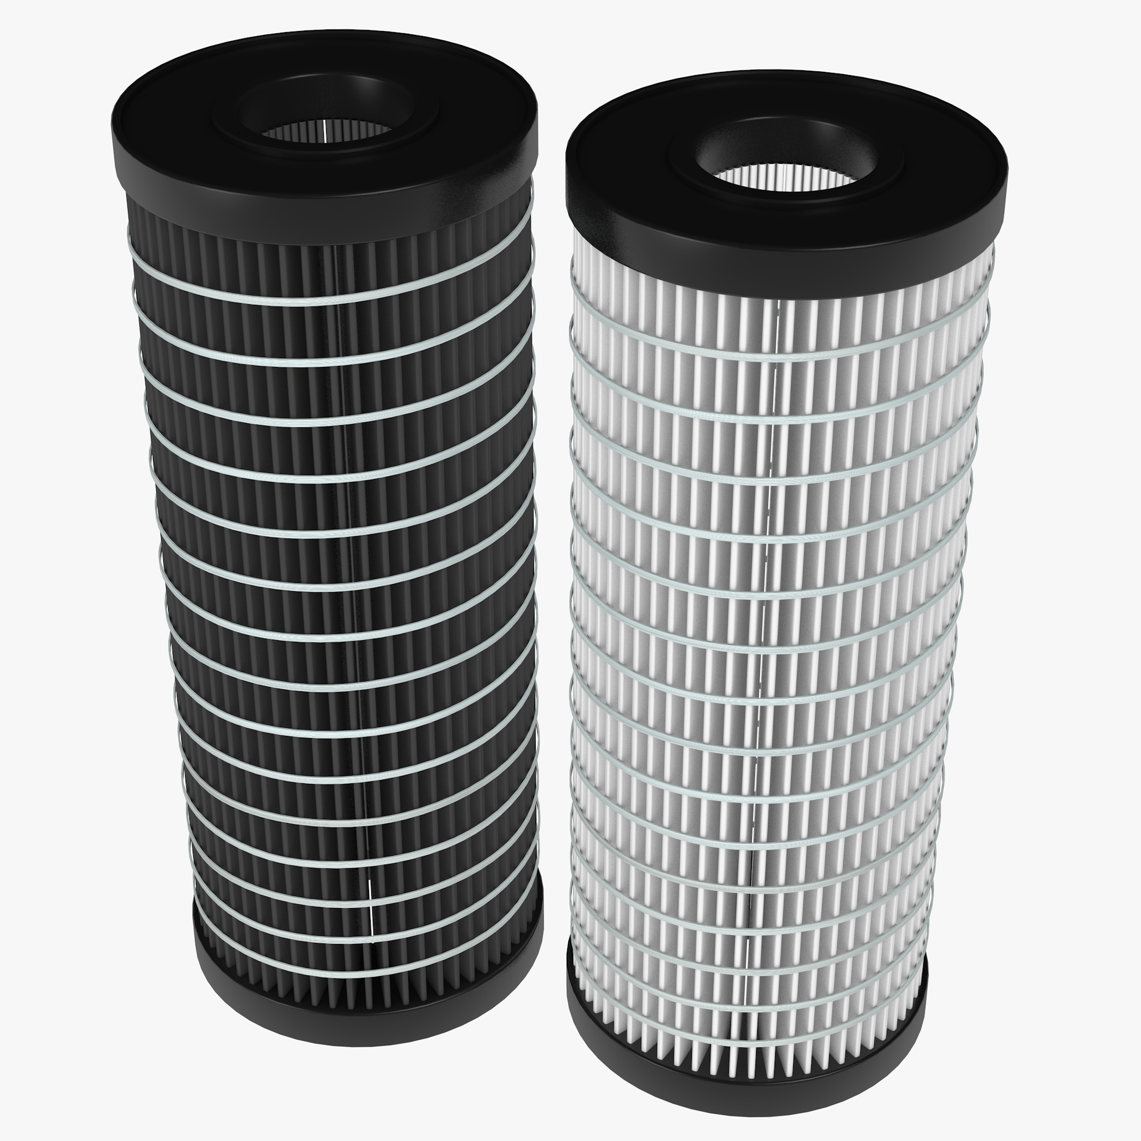
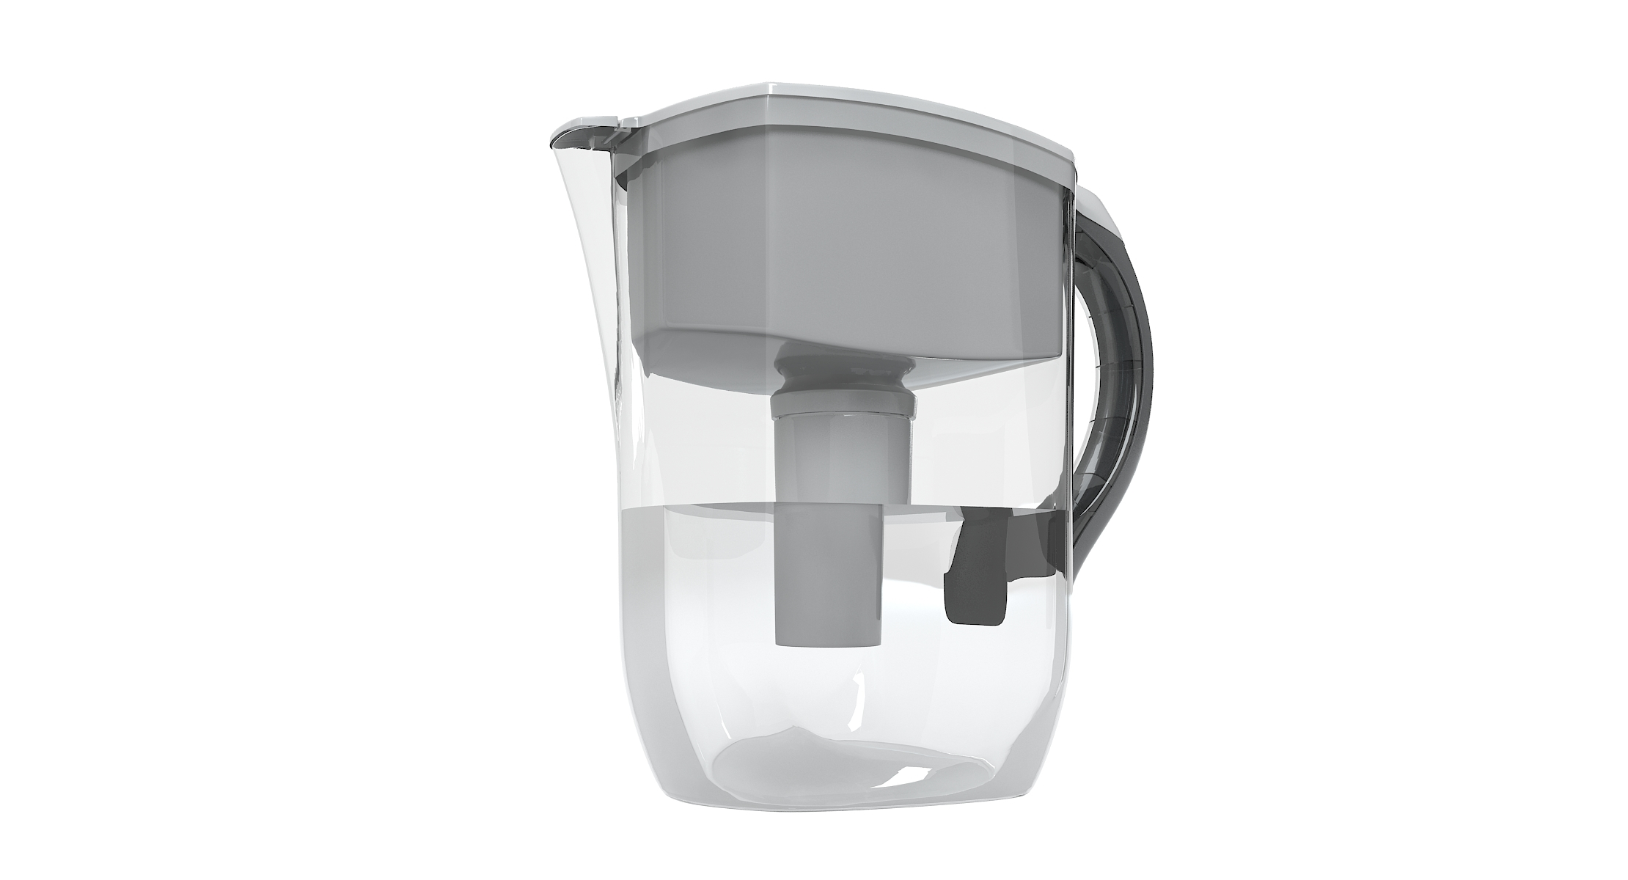
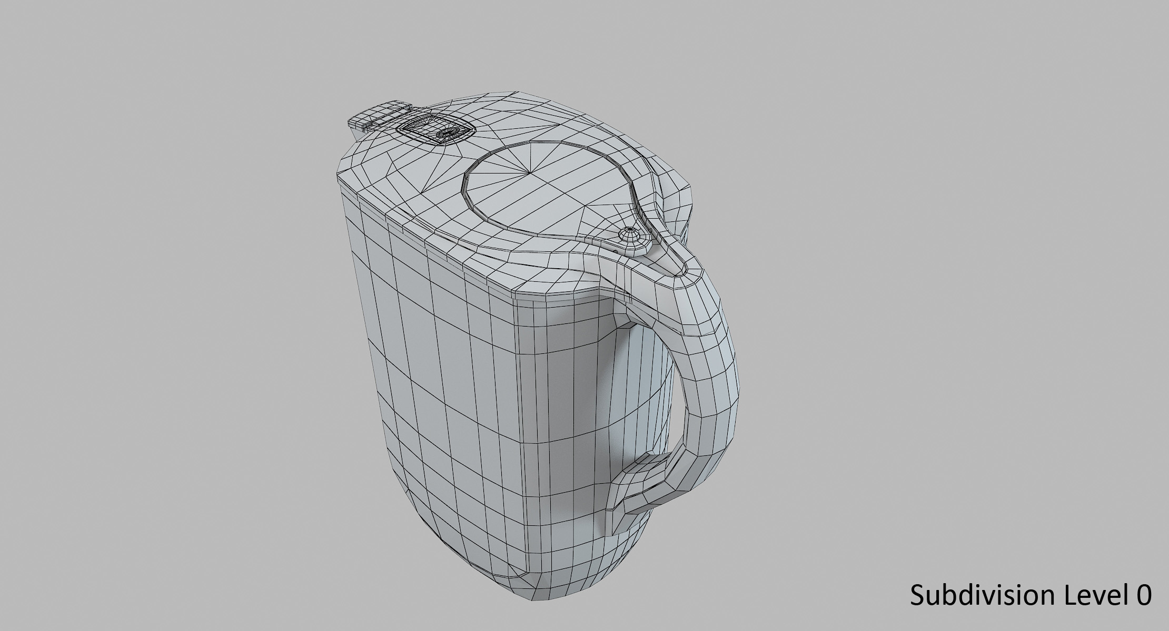

Product Prototypes
3D Models built using Blender 2.80
Tap Water Filter
Jug Water Filter
1st World Retailer:
0.5 GBP Retail
1st World Retailer:
5 GBP Retail
UN: 2 GBP Retail
1st World Retailer:
10 GBP Retail

Slide 16


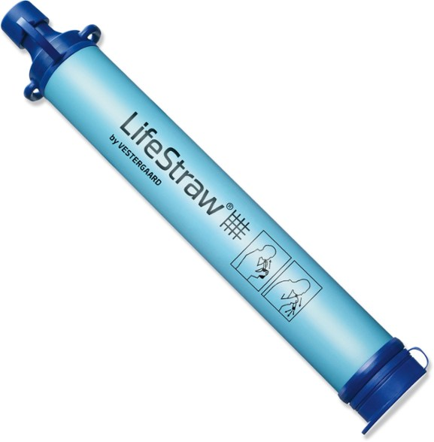
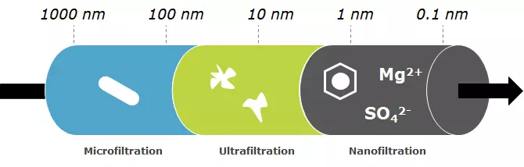
Competition
LifeStraw
Only a one-step filtration
Cost of product is high
NXFiltration
Filters out electrolytes and only pure water is left
Notes:
Our product
-Angstrom level filtration
-Eco friendly, sustainable and requires little ressources.
-The filters are easily replaceable.
-we can buy the filter paper from Thomasci for example.

Slide 17
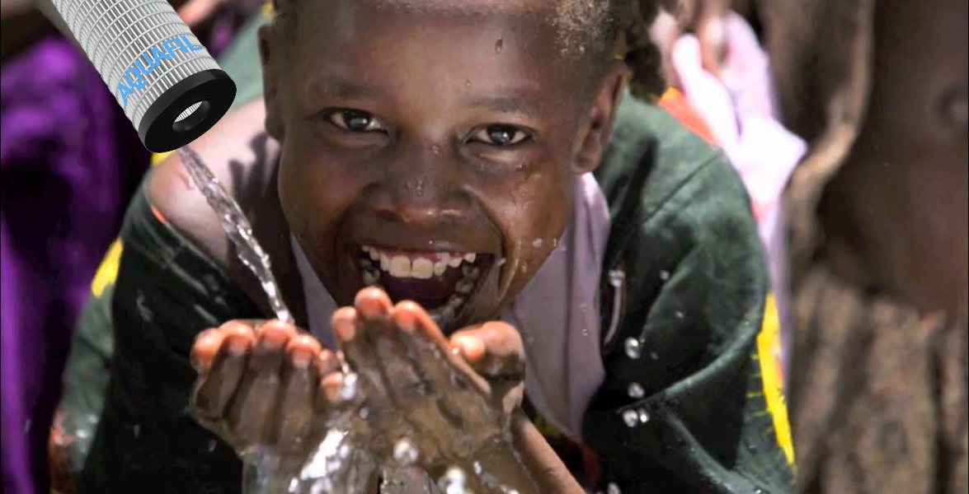

Slide 18
References
-https://www.ncbi.nlm.nih.gov/pmc/articles/PMC4544834/
-https://www.ncbi.nlm.nih.gov/pmc/articles/PMC3140680/
-https://www.sciencedirect.com/science/article/pii/S0376738819305290
-https://uknowledge.uky.edu/cgi/viewcontent.cgi?article=1096&context=cme_etds
-https://www.embl.de/pepcore/pepcore_services/protein_purification/extraction_clarification/lysis_buffer_additives/
-https://bitesizebio.com/9107/how-to-lyse-cells-for-protein-extraction/
-https://www.nxfiltration.com/products/nanofiltration/
-https://www.elisagenie.com/blog/ripa-recipe-cell-lysis-buffer/
-https://app.biorender.com/gallery/illustrations
-https://www.nature.com/articles/srep45089
-https://www.nature.com/articles/srep19893
-https://www.sciencedirect.com/book/9780128139264/nanoscale-materials-in-water-purification
-https://www.energy.gov/science/bes/articles/filtering-water-better-nature
-https://www.unicefusa.org/three-stories-about-how-clean-water-saves-kids-lives
-https://www.nxfiltration.com/products/
-http://news.bbc.co.uk/media/images/46424000/jpg/_46424101_dirty_water766.jpg
https://www.happinessishomemade.net/wp-content/uploads/2015/07/Drink-Water.jpg
https://alivenewspaper.com/wp-content/uploads/2018/04/Cases-of-Unsafe-Drinking-Water-in-the-US-Already-in-2018.jpg

